Slide 1

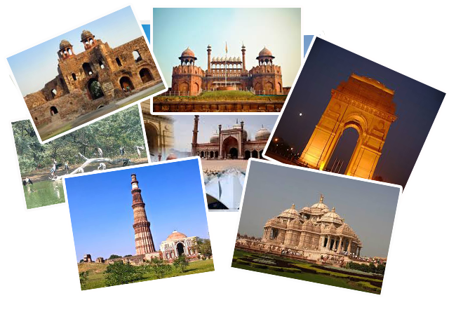

PROJECT PRESENTATION

Slide 2
PROJECT DOCUMENTATION
PROJECT TITLE – PACK & GO
DATE – 25/05/2022
PROJECT TEAM MEMBERS –
Priyansh Mani Tripathi, Satish Mishra, Priyanshi Jaiswal , Satyam Pandey , Manshi Raj

Slide 3
1. INTRODUCTION
The main objective of the project Pack & Go Website is to manage the details of Travel, tours, hotels, Facility. It manages all the information about Travel, Customers, Facility. The purpose of the project is to reduce the manual working for Travel, Tour, and Customer. The user can select a location to see and get all information regarding that place.
The Pack & Go Website enables users to locate distinct places to visit. They get a detailed description of the site along with the nearby places that they can see. Using this application, the user can select a location to see and get all information regarding that place.
This website is entirely interactive and smooth and allows the user to figure out things quickly.

Slide 4
2. DESIGN AND FUNCTIONAL SPECIFICATION
Main Screen: It will consist of a home page, tour page (to see destination information along with the nearby places) hotels (to get the knowledge of the hotels), services (search facilities provided by hotels), about, blogs, and contacts.
Booking Services: it will provide 4 main features, which are: 1) Flight Booking 2) Hotel Booking 3) Car Rent and 4) Cruises.
Find Tour Service: Here people can easily get information about the places they want to visit. It tracks all the detail about the Hotels, places and their facilities.
Hotel Facility: It provides the option of booking hotels for a trip for customers and also gives the booking sites and hotel recommendations with web links to hotels and booking sites.

Slide 5
Restaurant Facility: It also provides restaurant services and provides all the pieces of information about restaurant availability and places to be viewed on a tour
User Information Page: It maintains the customer details of the package and payment receipt and also provides all the package Details. It also manages all the information about the tour
Login Page: This page is for those users who have already registered themselves on the website and have a username and a password. There is also a way on this page for the new users to register themselves which will take them to the registration page.
Registration Page: This page is solely designed for the new users of the website who are willing to register themselves. This page takes the input of the various details of the user and stores it in the database, later helping the user to login into the account with the credentials they have provided.

Slide 6
3. HARDWARE AND SOFTWARE REQUIREMENTS
Software:-
Technology Implemented: Full Stack Technology
Language Used : HTML, CSS, JavaScript, BootStrap
Database: MongoDB
User Interface Design: Html, CSS, JavaScript, BootStrap
Platform Used: VS code
Web Browser: Chrome/Firefox
Hardware:-
Operating System: Windows 7/8/10/11
RAM: 4+GB
Hardware Devices: Computer System
Hard disk: 64 GB
Display : 3 nets display with 1280*720 minimum resolutions

Slide 7
4. Sources
https://priyanshi-2705.github.io/PackandGo/

Slide 8
5. PROBLEM STATEMENT AND ITS SOLUTION
PROBLEM AND ITS SOLUTION :
As we know that all the records are not kept perfectly because all the work is done manually, so keeping up-to-date details of the timings of bookings, seat availability for reservation, and rooms/hotels availability is not done.
To sort all of these problems we have introduced the PACK & GO Website, so it maintains the customer details of the package and payment receipt and also provides all the package Details. It also manages all the information about the tour.

Slide 9
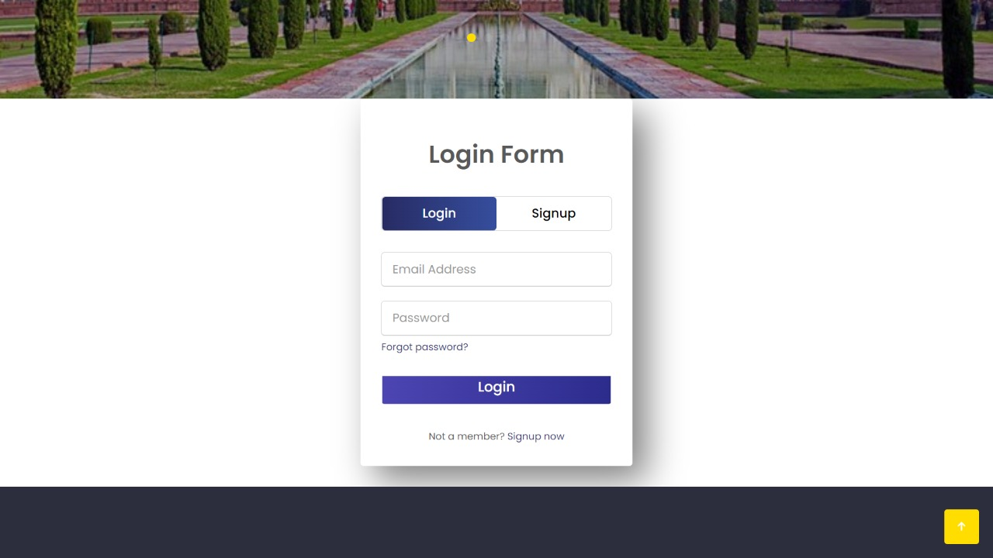
6. LOGIN PAGE

Slide 10
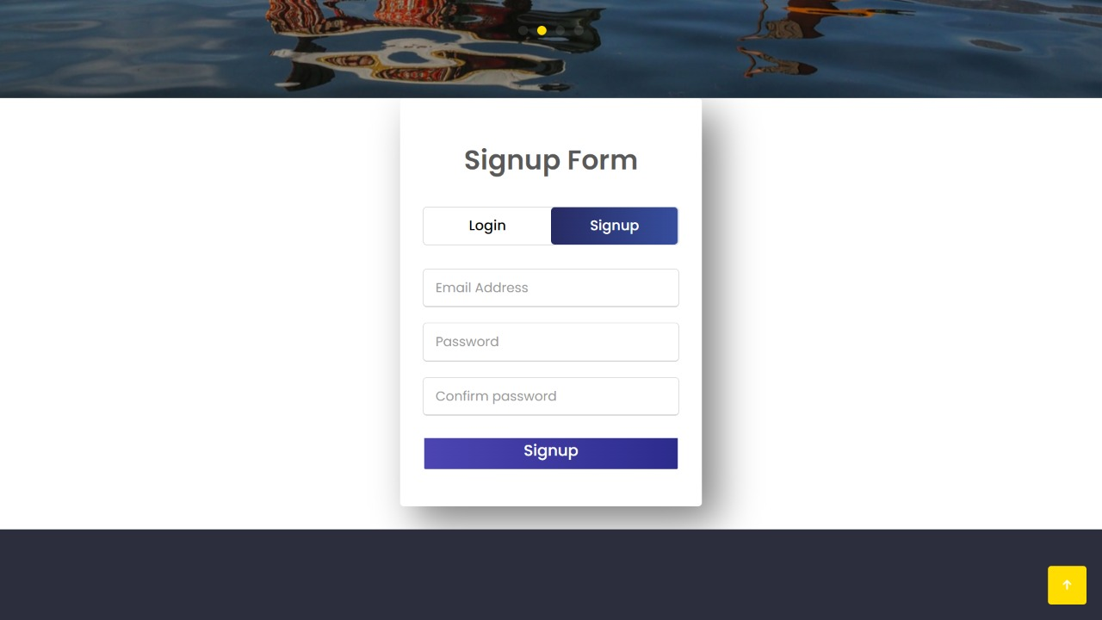
7. Registration PAGE

Slide 11
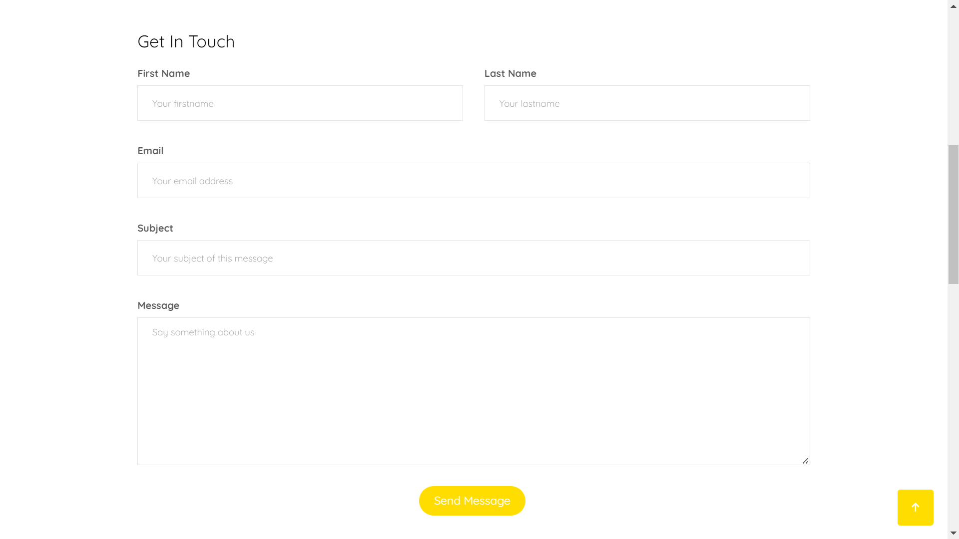
8. User INFORMATION PAGE

Slide 12
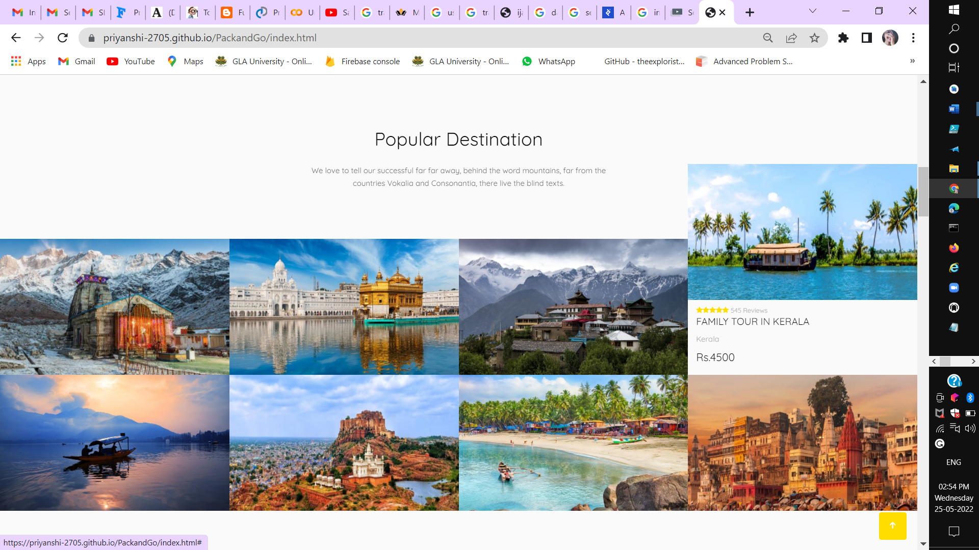
9. RECOMMENDATION PAGE

Slide 13
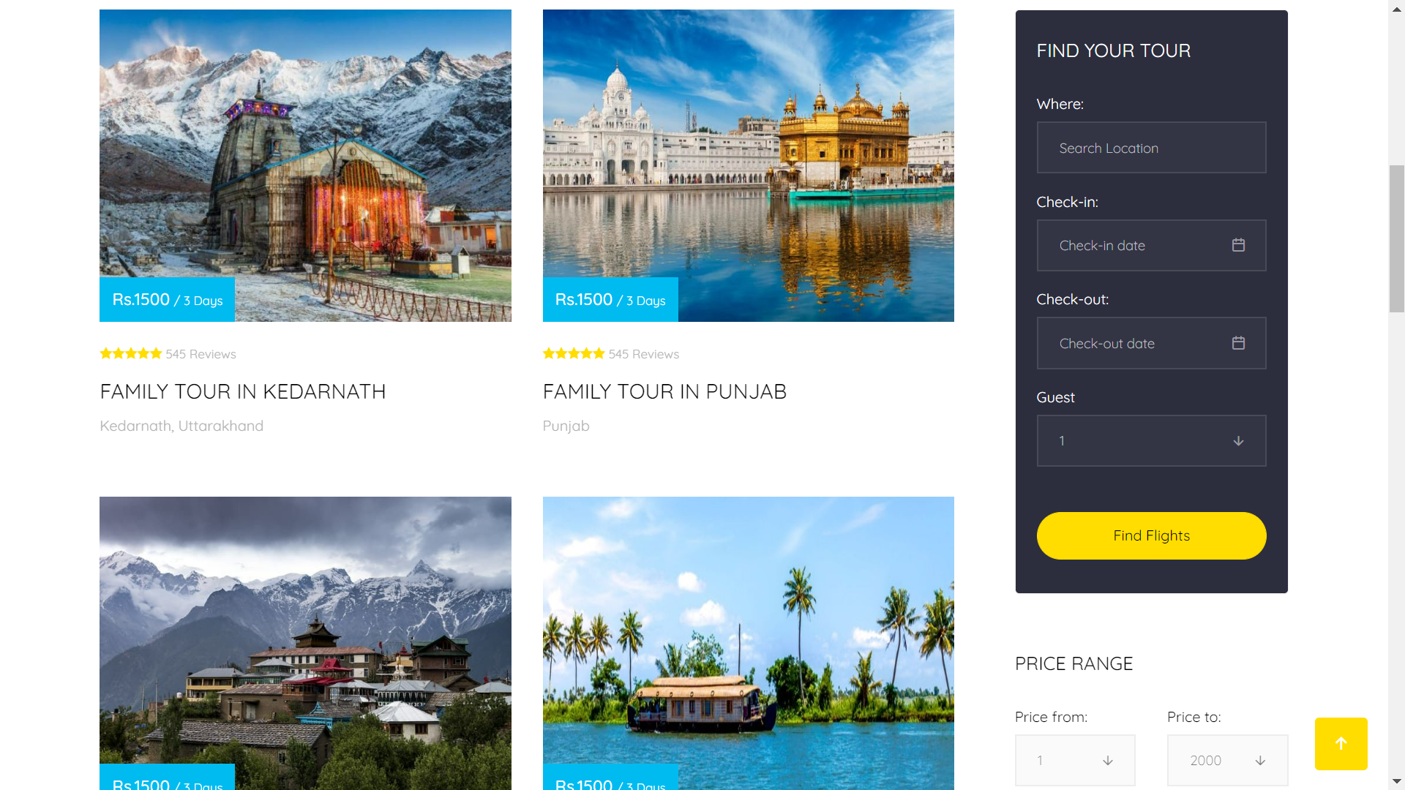
10. TOUR PAGE

Slide 14
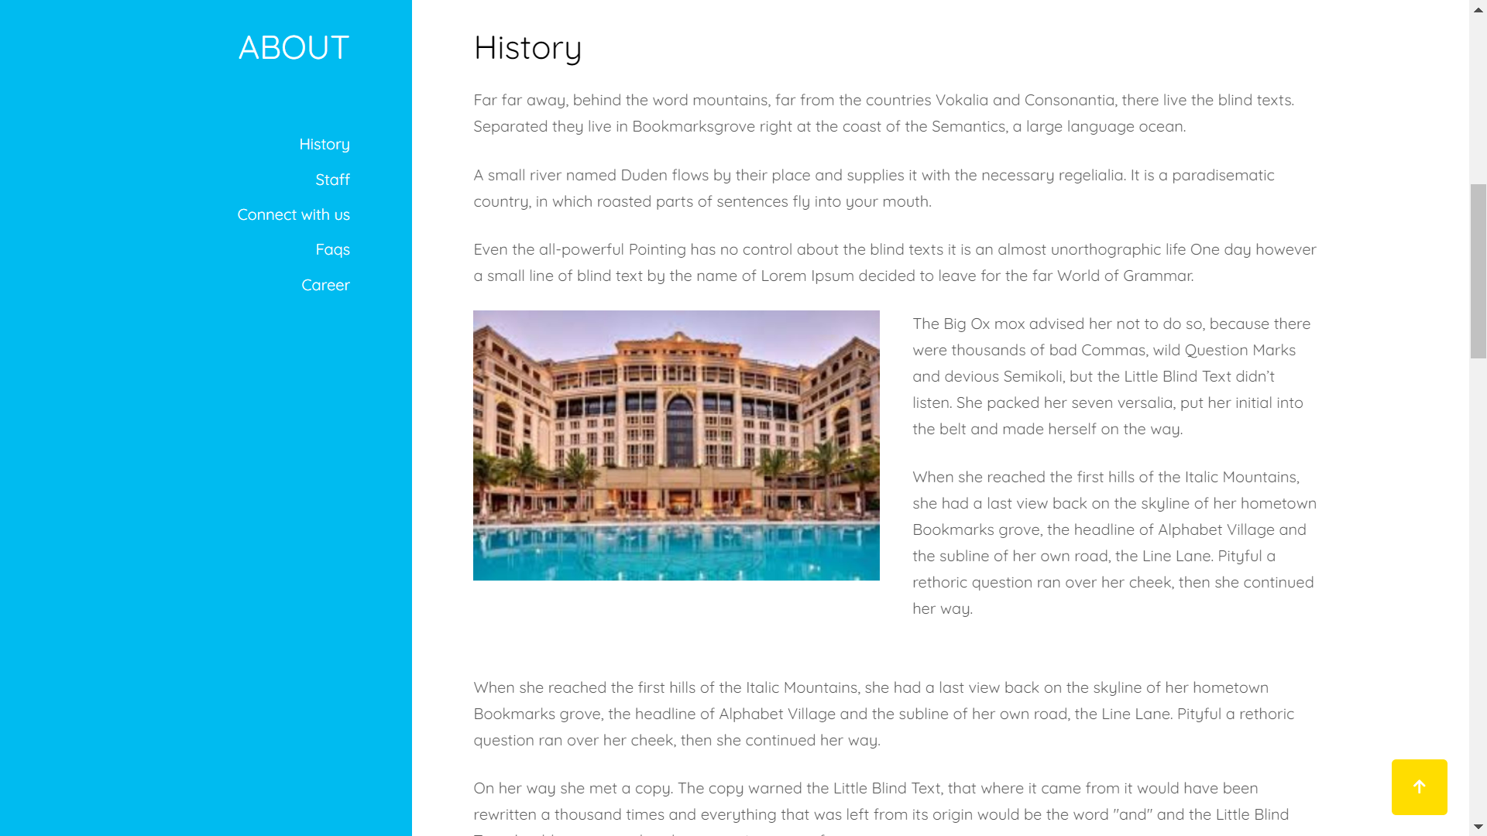
11. ABOUT PAGE

Slide 15
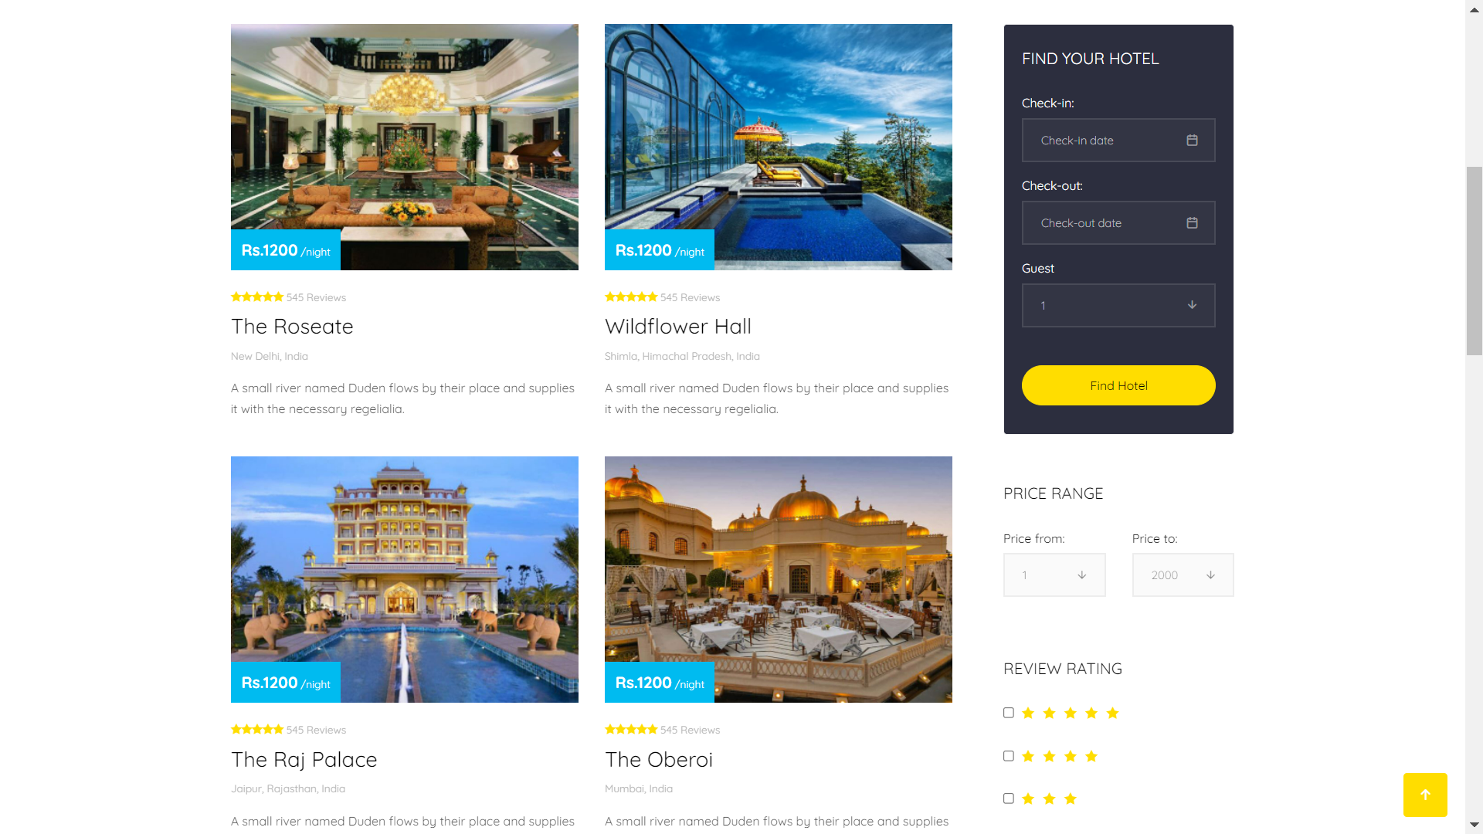
12. HOTEL PAGE

Slide 16
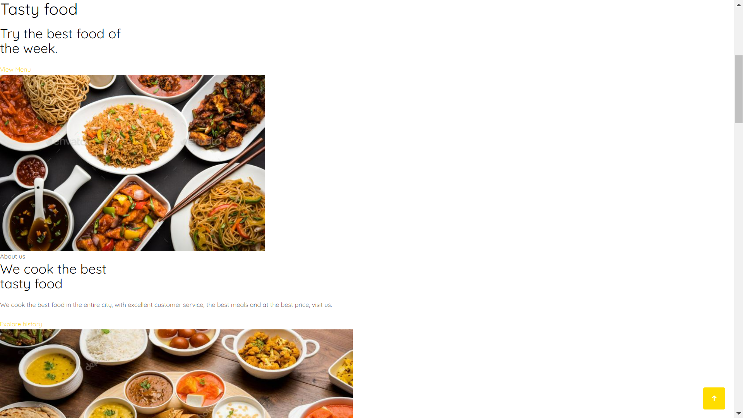
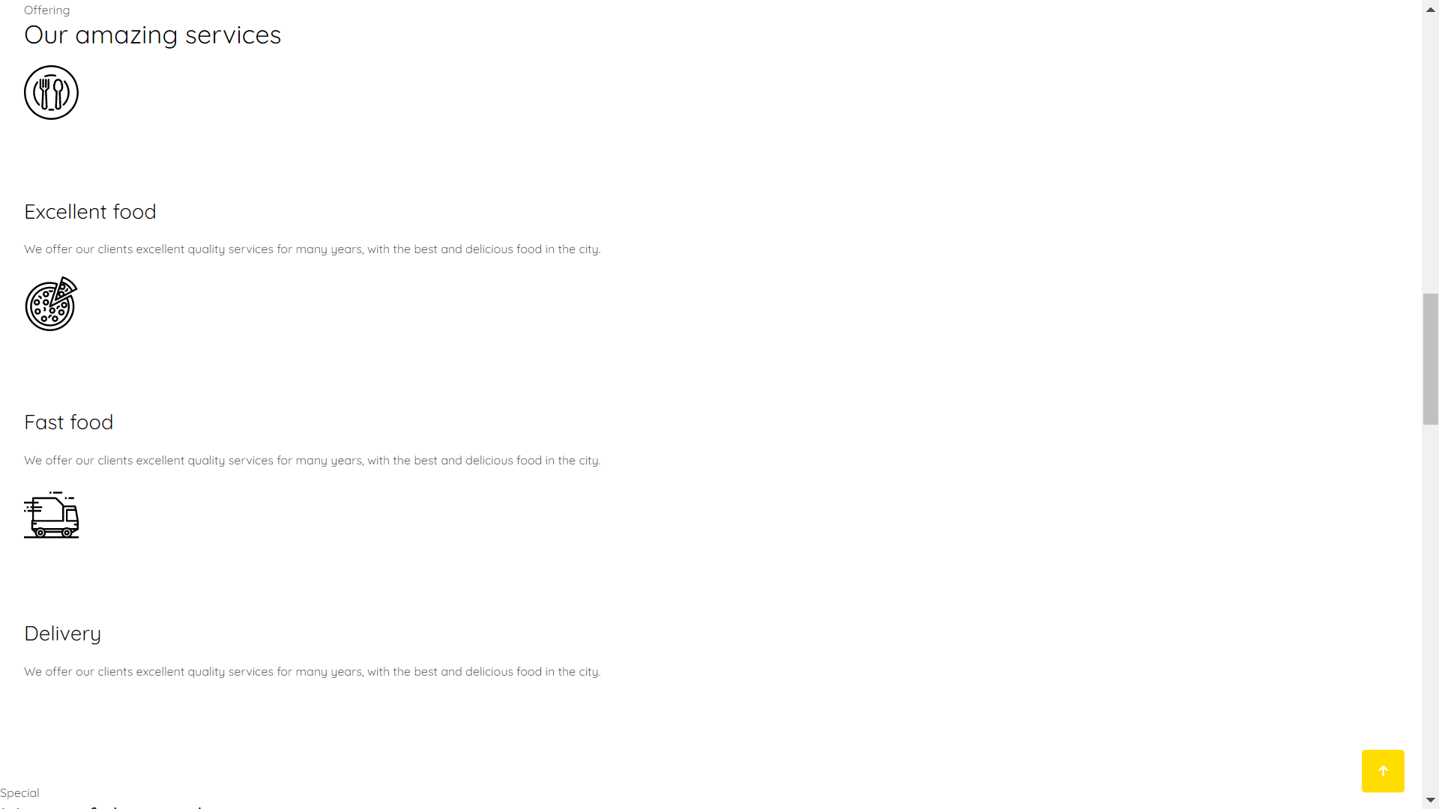
13. RESTAURANT service PAGE

Slide 17
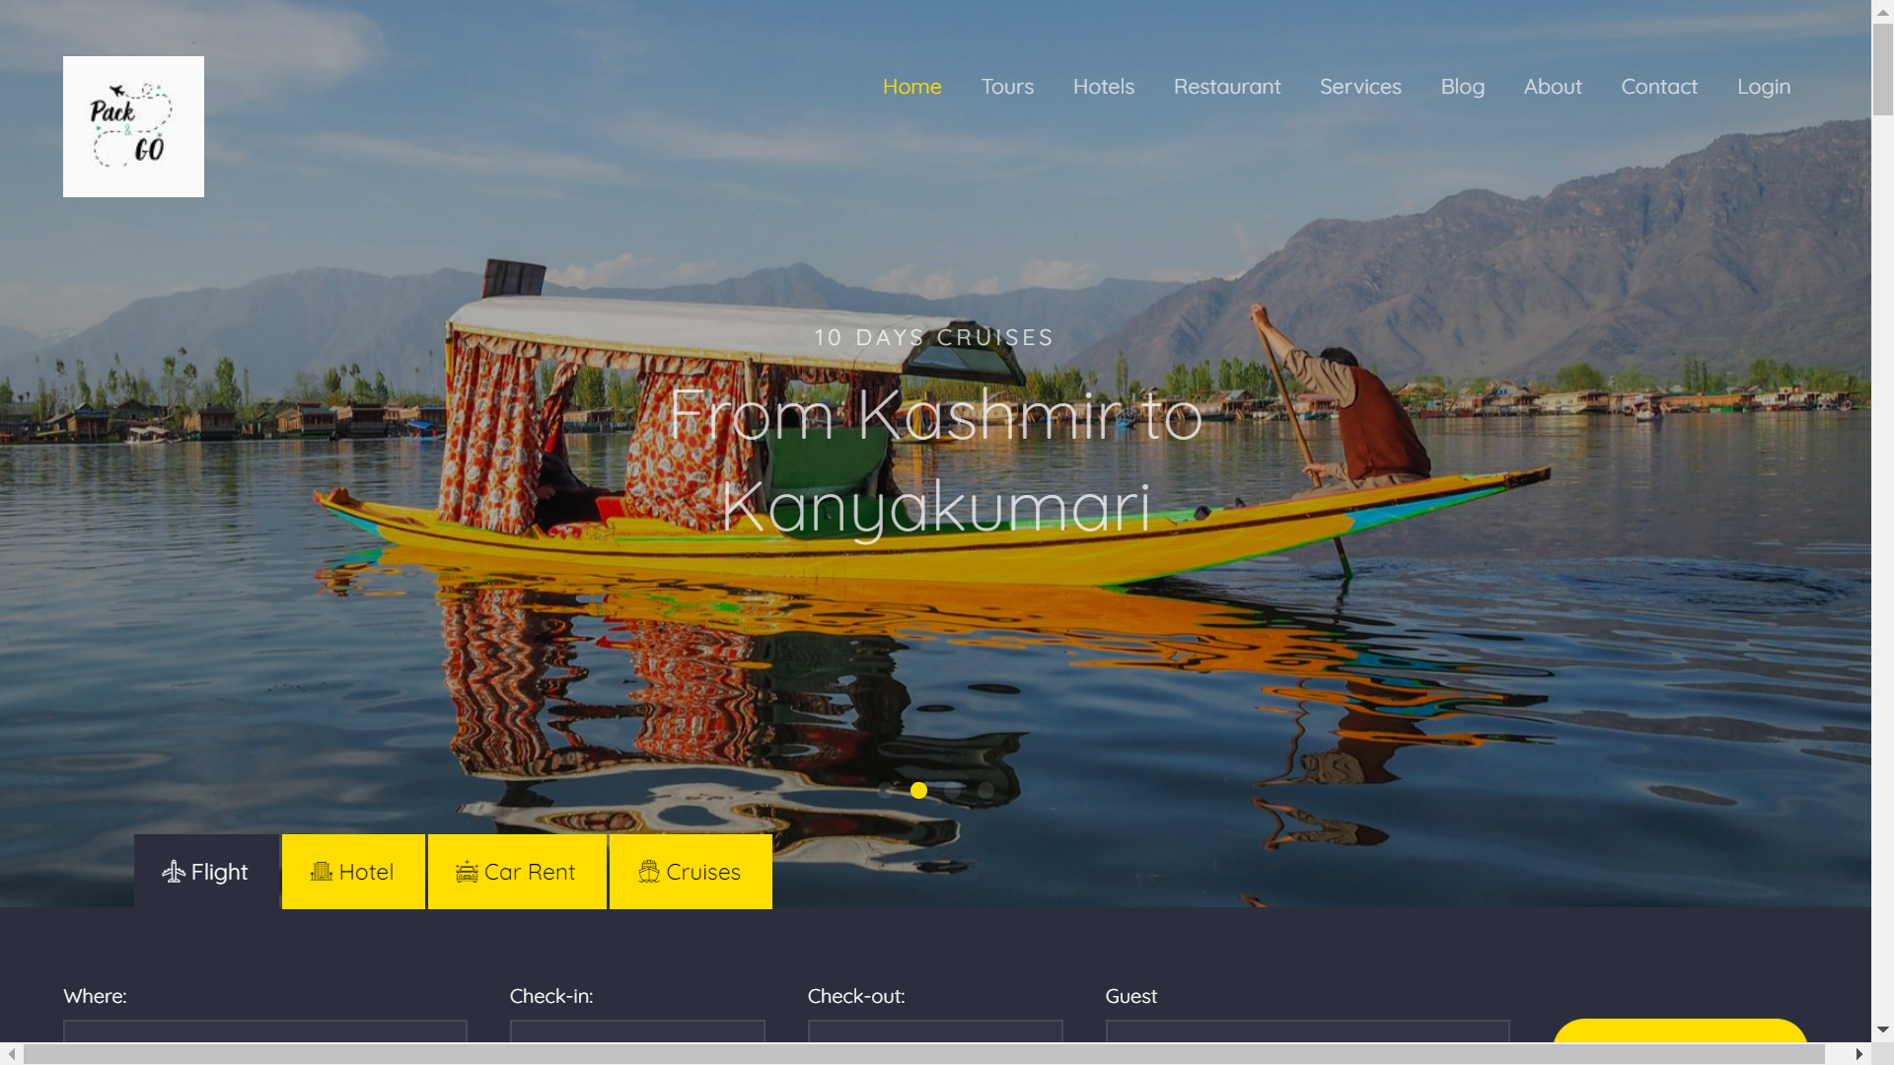
14. Dashboard PAGE

Slide 18
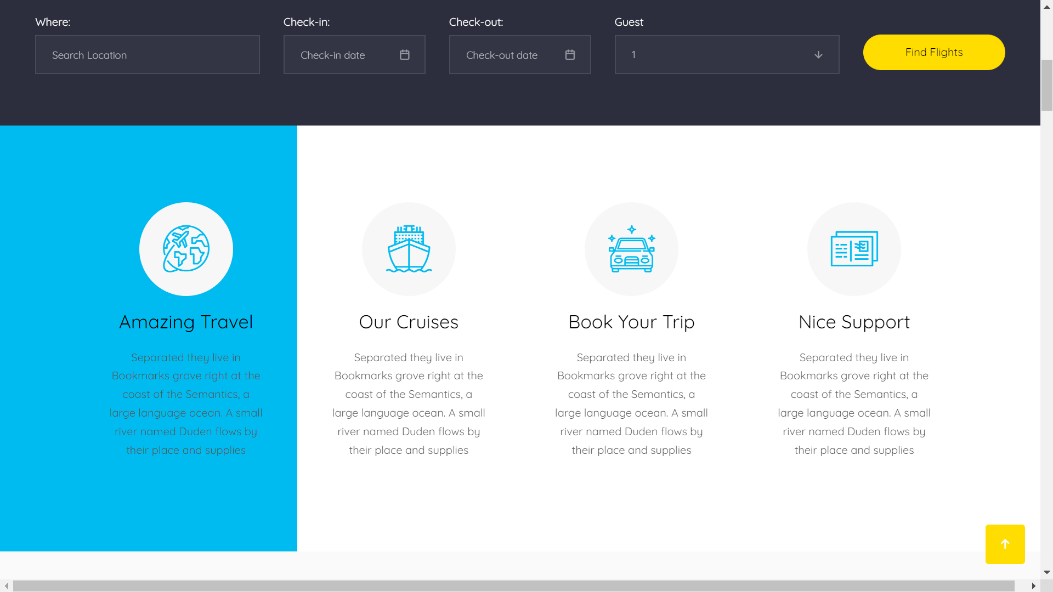
15. services PAGE

Slide 19
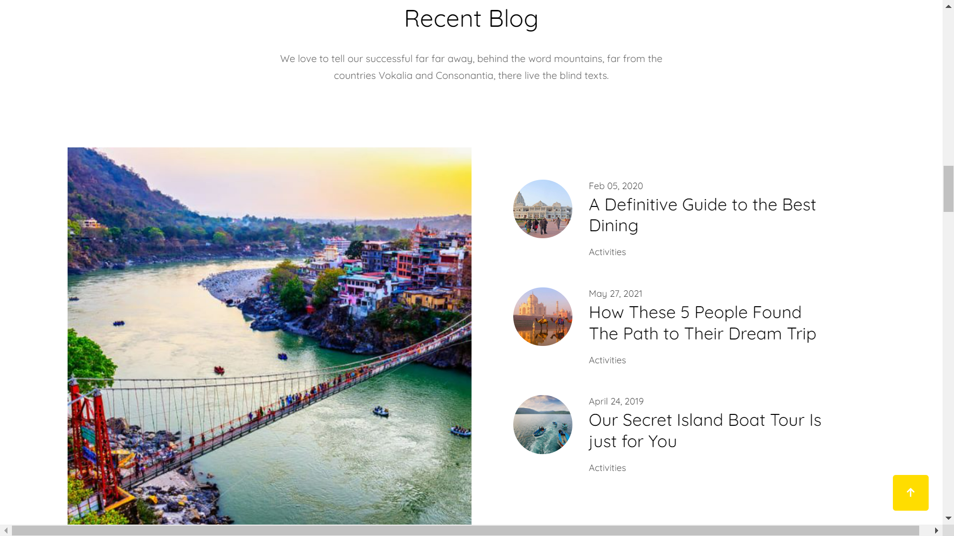
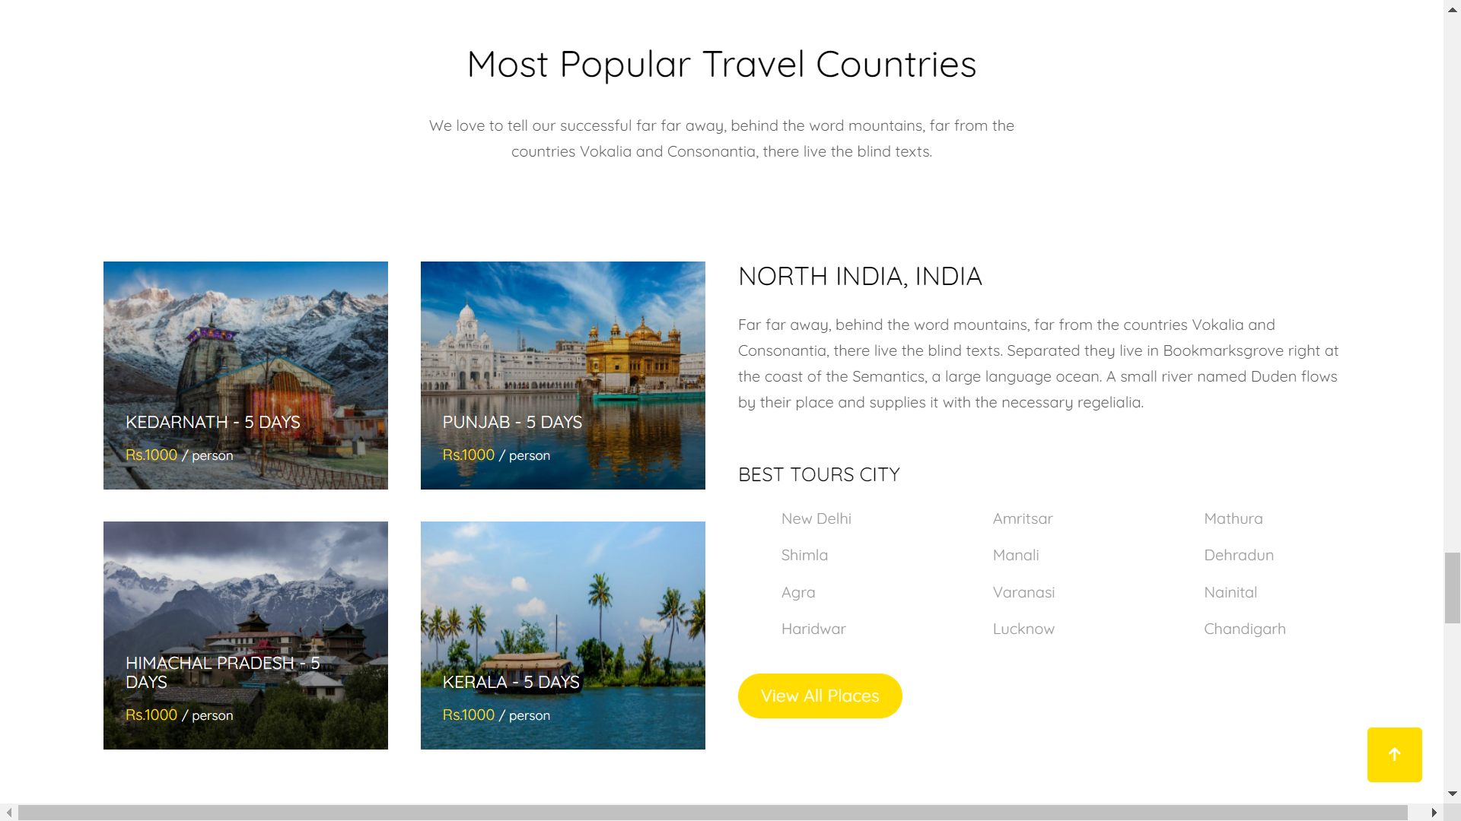
16. BLOG PAGE

Slide 20
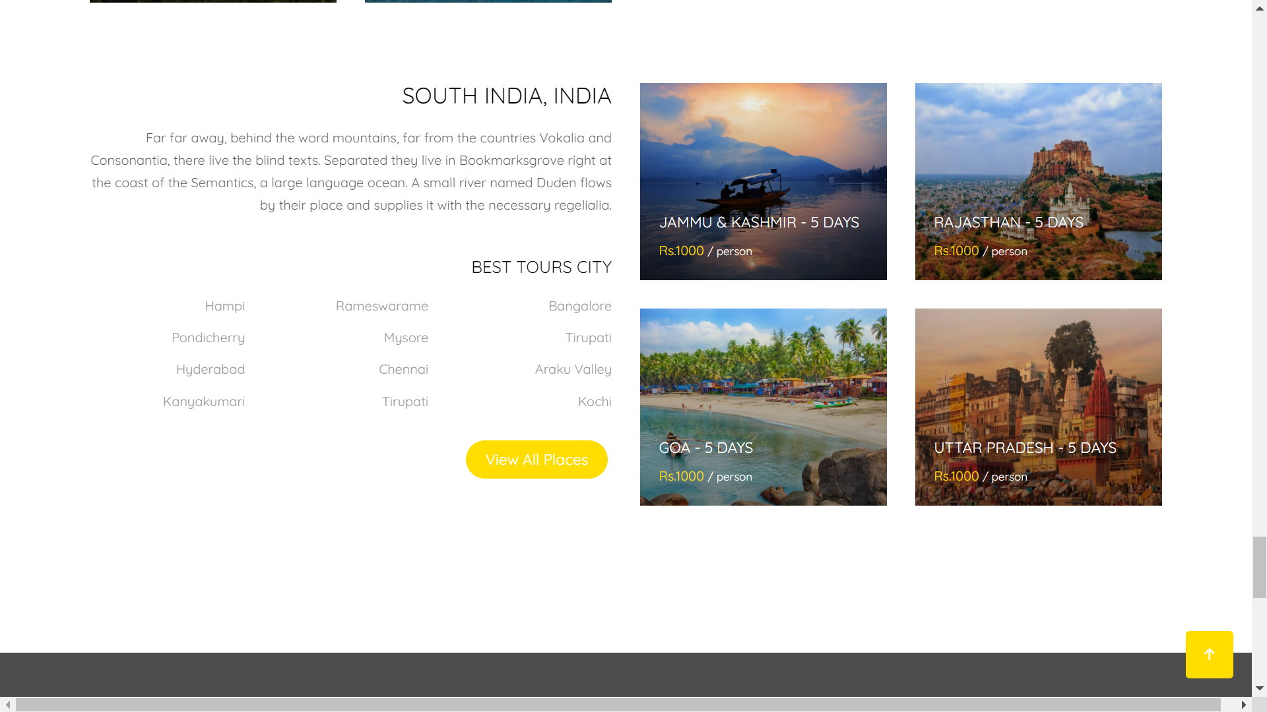

Slide 21
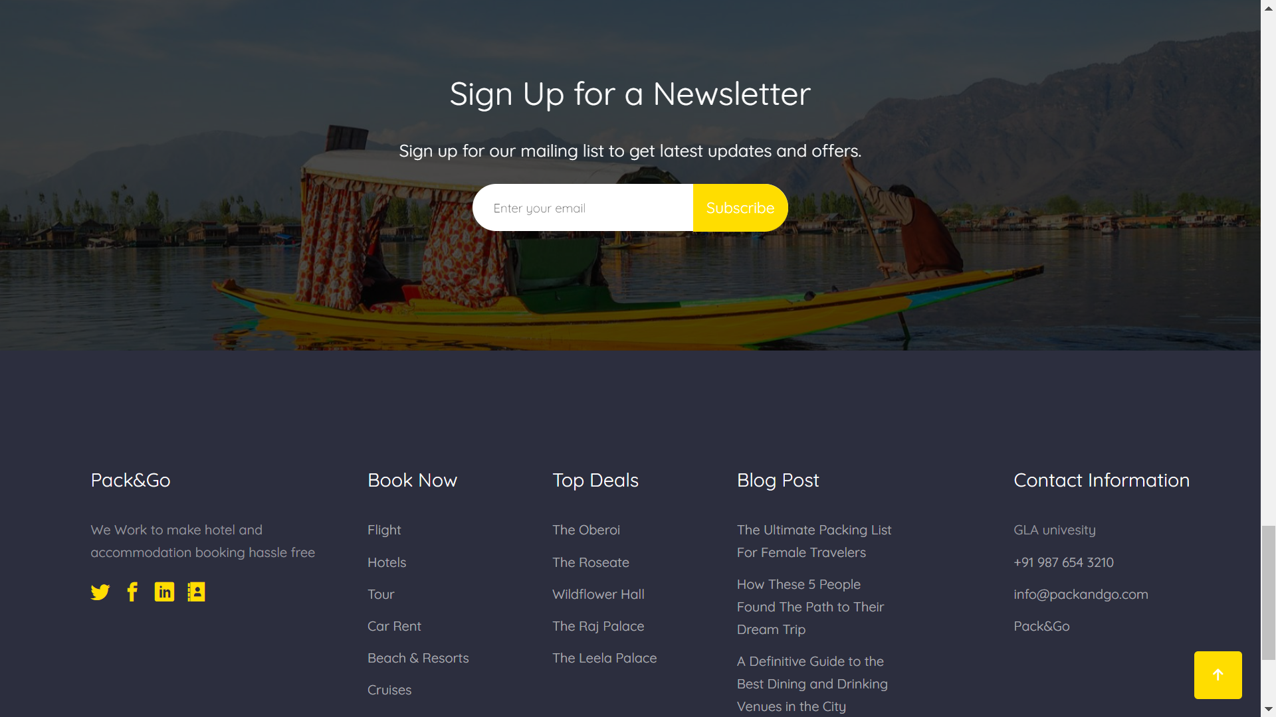

Slide 22
17. CONCLUSION
Our Website (PACK & GO) satisfies the user requirement. It is easy to understand by the user and operator. Be easy to operate. It also provides a good interface. And delivered on schedule within the budget.
We will provide a searching option where people can easily get information about the places they want to visit. Deciding that this would be an interesting, challenging project whose topic we are passionate about, we felt this would be a good choice for our project.

